Slide 1
Using Error Level Analysis to remove Underspecification
ENS Paris-Saclay, MVA 2022-2023
Jérémie Dentan, École Polytechnique, France
March 17th, 2023
This presentation comes with a technical report and a GitHub repository. It presents the work of the author on a data competition.
The competition: https://challengedata.ens.fr/participants/challenges/95/
The technical report: http://dx.doi.org/10.13140/RG.2.2.25127.21925
The GitHub repository: https://github.com/DentanJeremie/age-underspecification.git

Slide 2
Content
I- Introduction
II- What is underspecification?
II- First approach: DivDis with a pretrained head
III- Second approach: using ELA for text removal
IV- Conclusion

Slide 3
Content
I- Introduction
II- What is underspecification?
II- First approach: DivDis with a pretrained head
III- Second approach: using ELA for text removal
IV- Conclusion

Slide 4
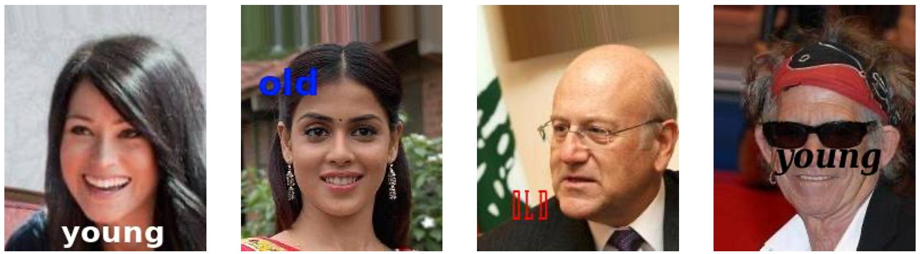
I- Introduction: The challenge
Huge distribution shift between the train and test set
The task: predict age from ambiguous data
Train
Train
AYTY
AYTO
AOTO
AOTY
A=Age, T=text, Y=Young, O=Old
Test

Slide 5
I- Introduction: The datasets
Two datasets: 2000 + 89732 JPEG-RGB images, size 178x218
human_hair
human_age
Train (1000 img)
Test (1000 img)
Train (20000 img)
Test (69732 img)
HLTL
HLTL
AYTY
AYTY
HLTD
AYTO
HDTD
HDTD
AOTO
AOTO
HDTL
AOTY
HLTL, HDTD, HLTD, HDTL are que equivalent of AYTY, AOTO, AYTO, AOTY, replacing the Age by the Hair, and Old/Young by Light/Dark

Slide 6
I- Introduction: The rules
Ref: [6] (ImageNet) ; [6, 18, 20] (age prediction models) ; [1, 13, 14] (OCR)
Some rules were there to make the challenge harder.
No manual annotation
We need machine learning techniques
No other data
We cannot scrap data to train an age classifier
No pretrained model, except the ones trained on ImageNet
We cannot used pretrained age classifier
Difficult to use out-of-the box OCR, often pretrained

Slide 7
Content
I- Introduction
II- What is underspecification?
II- First approach: DivDis with a pretrained head
III- Second approach: using ELA for text removal
IV- Conclusion

Slide 8



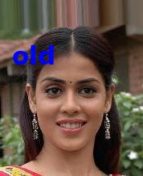
II- Underspecification: What is it?
Ref: [2, 4, 5, 8, 19]
Synonym: ambiguity of the data
During the training, the simplest predictor is learnt, however it is not always the one that have the best performance on the test set
Train
Test
Text-based predictor
100% accuracy
Easy to learn
50 % accuracy
Learnt
Face-based predictor
100 % accuracy
Hard to learn
Not learnt
100 % accuracy

Slide 9
II- Underspecification: One solution: DivDis
Ref: [12]
DivDis is an architecture that uses both the train and test set during the training, encouraging disagreement between the two predictors it learns.
Train set
Test set
Text-based predictor
Prediction
Learnt
Encourage disagreement
Face-based predictor
Learnt
Prediction

Slide 10
II- Underspecification: Discussion on DivDis
Ref: [12]
DivDis is hard to apply in real life, because we need an expert to understand where the ambiguity comes from and how to characterize it.
Challenges with the architecture:
Need to be sure there is a distribution shift between two datasets
Need to choose which predictor to deploy on real data
➔ Requires an expert to understand the ambiguity and characterize it
Approach 1
Use the DivDis architecture
Characterize the ambiguity a posteriori
Choose one of the two predictor
Approach 2
Characterize the ambiguity a priori
Remove it
Train a single predictor

Slide 11
Content
I- Introduction
II- What is underspecification?
II- First approach: DivDis with a pretrained head
III- Second approach: using ELA for text removal
IV- Conclusion

Slide 12
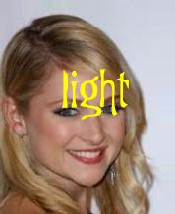
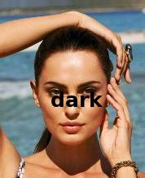
III- First approach: DivDis with a pretrained head
Ref: [12] (DivDis) ; [6] (ImageNet) ; [9] (ResNet)
To adapt the DivDis architecture to our problem, we wanted to pretrain one of the two heads to read the text on the images.
human_hair + human_age
Merging the two datasets, the text was supposed to be no longer correlated with the image
4-label classification
ResNet50 architecture
Frozen backbone
20% images for validation
Data replication to have balanced dataset, with: (1) Gaussian noise (2) Rolling color channels (3) Reverting lightness
This did not work well on the unlabeled image, so we abandoned this approach

Slide 13
Content
I- Introduction
II- What is underspecification?
II- First approach: DivDis with a pretrained head
III- Second approach: using ELA for text removal
IV- Conclusion

Slide 14
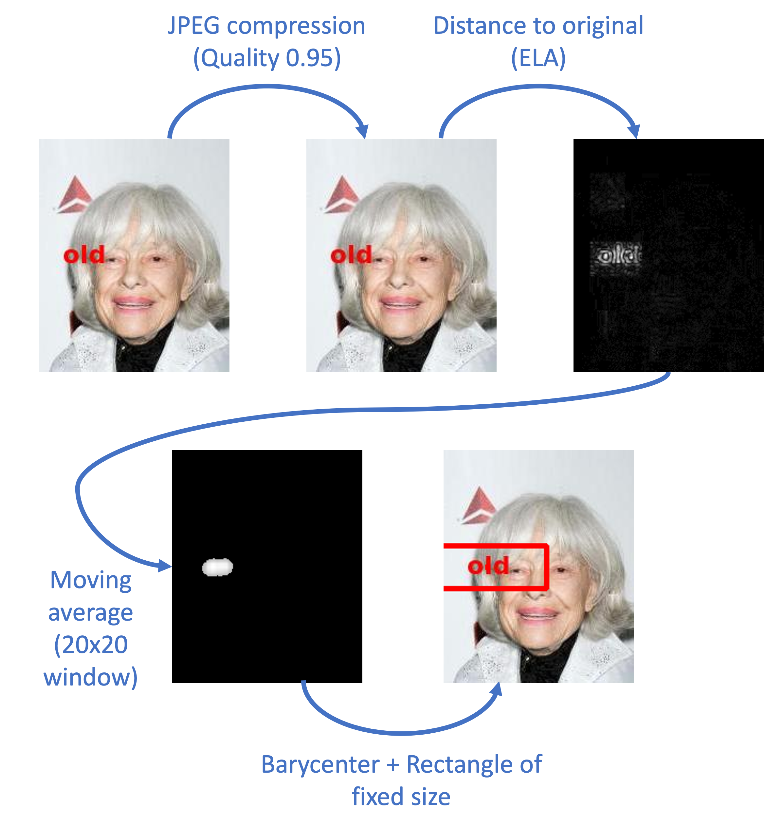
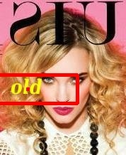
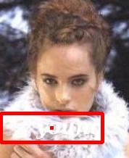
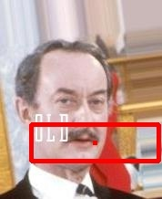
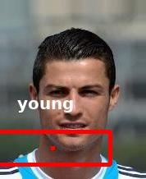
III- Second approach: Removing the text
Ref: [16] (Forensic techniques) ; [24] (ELA for forgery detection) ; [23] (JPEG compression)
We adapted a forensic technique called Error Level Analysis (ELA) to remove the text from the image, with perfectly worked in 91% of the cases.
Some examples of detections:
Image 1 and 2: correct detection, as in 91% of cases. The detection was difficult: presence of another text in the image or low contrast.
Image 3 and 4: partially incorrect detection or fully incorrect detection, as respectively in 4% and 5% of cases.
The accuracy rates are manually evaluated using 200 random images.

Slide 15
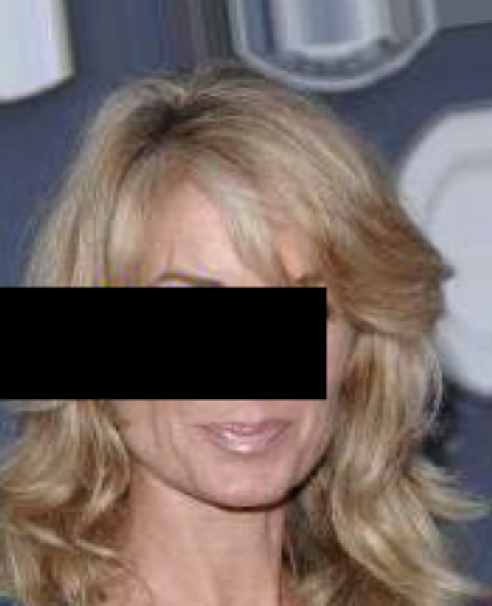
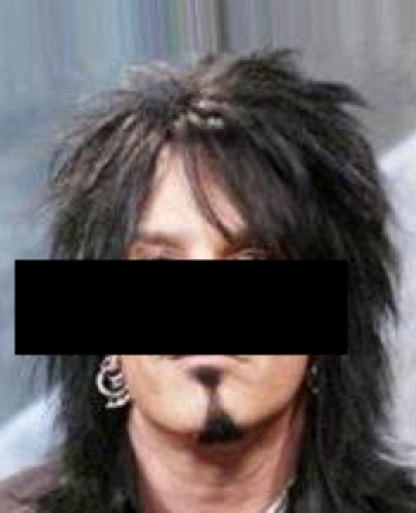
III- Second approach: Training the classifier
Ref: [10, 20] (Age classification pipelines) ; [9, 22] (ResNet50, VGG19) ; [11] (Adam)
After having removed the text, we trained a binary classifier, leading to a final accuracy of 73% (vs. 64% for the DivDis baseline).
data
Some metrics:
73% accuracy on test set (vs. 64% for the DivDis baseline).
CPU for text removal: Intel Xeon W-1290P 3.70GHz, 20 virtual cores: 455sec, i.e. about 10sec/img/proc
GPU for age prediction: NVIDIA GeForce RTX 3090 24Go: 760sec/epoch, i.e. about 2h45 total training time per model
Binary classification
ResNet50 and VGG19 architectures
Adam Optimizer
Binary cross-entropy
20% images for validation
Gradual unfreezing across 13 epochs
Early stopping and memorization of the best validation accuracy
Data replication with gaussian noise

Slide 16
Content
I- Introduction
II- What is underspecification?
II- First approach: DivDis with a pretrained head
III- Second approach: using ELA for text removal
IV- Conclusion

Slide 17
IV- Conclusion
We have tried two different approaches to fight the ambiguity of the data at hand
Removing the ambiguity a priori does not require more domain knowledge than doing it a posteriori as with DivDis
We showed that simple forensic techniques can prove to be very efficient to detect some patterns to remove the ambiguity
We obtained a satisfying final accuracy of 73% (vs. 64% for the DivDis baseline)

Slide 18
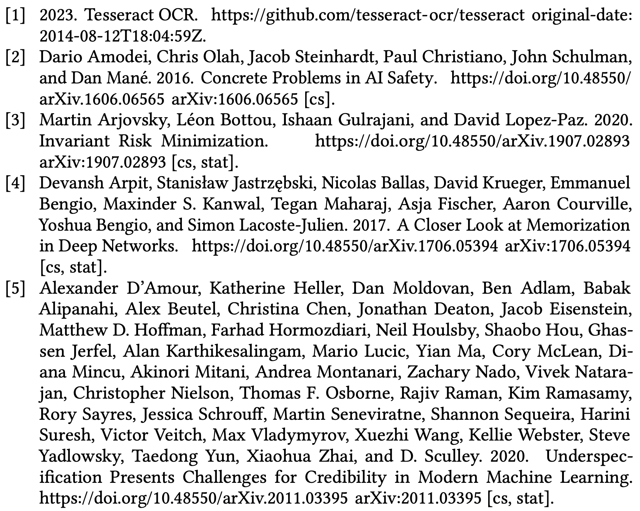
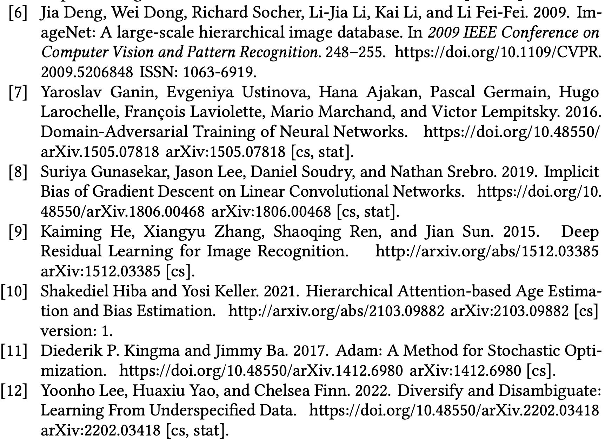
References

Slide 19
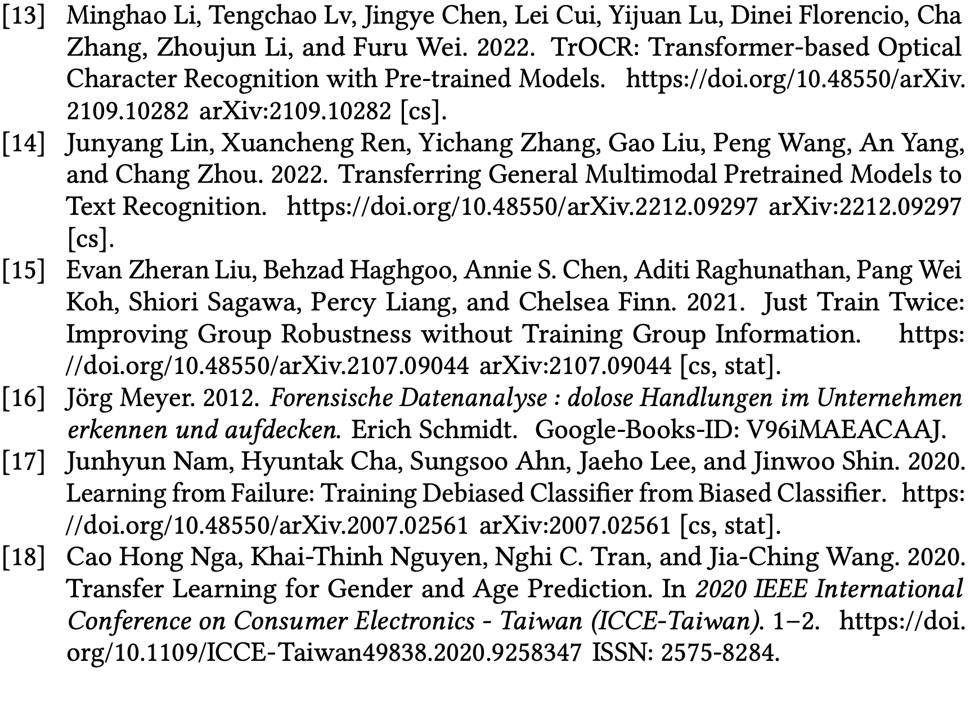
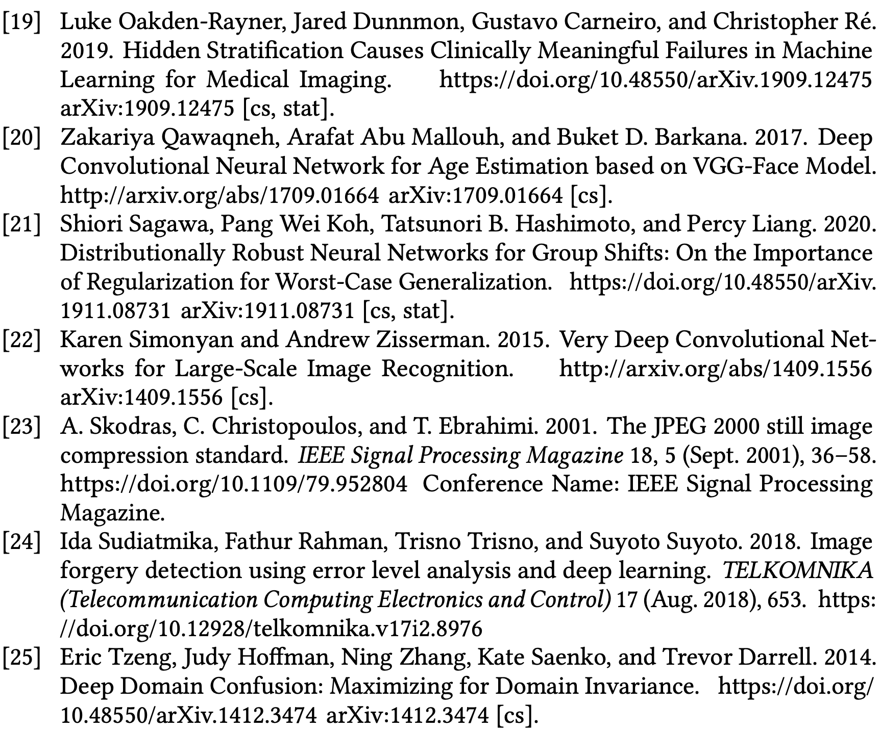
References

